Slide 1

Thesis Investments Committee (WIP)

Slide 2
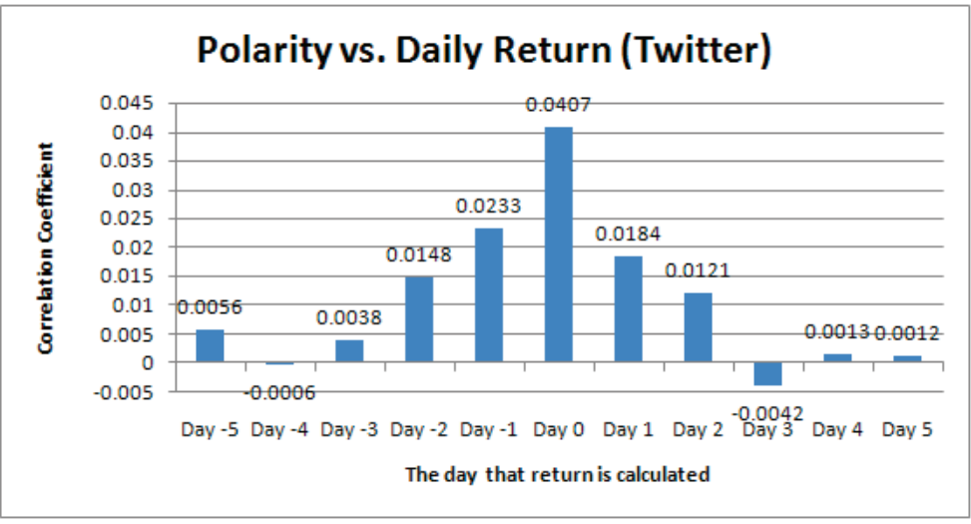
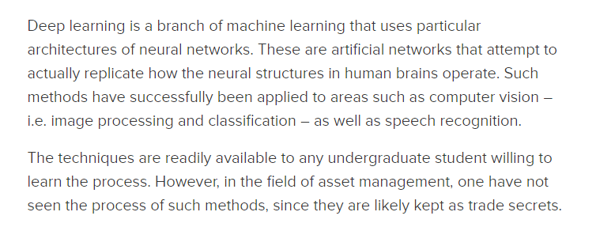
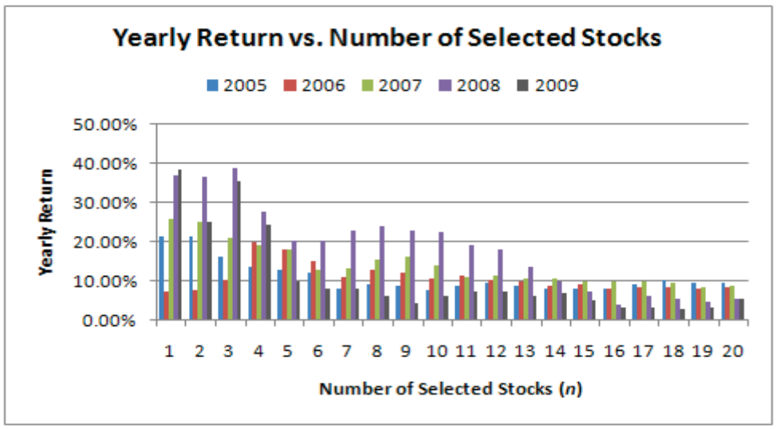
How do you use programming in Asset management?
Source: our own Canberk on The Market Mogul!
Source: Zhang, W., & Skiena, S. (2010, May).
Trading Strategies to Exploit Blog and News Sentiment. In Icwsm.

Slide 3
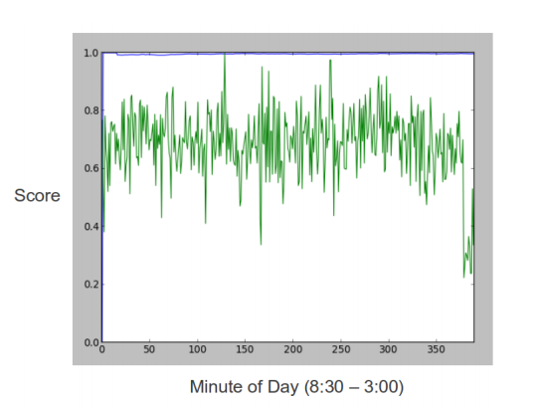
Other side of the story
Source: Zhang, L.
Sentiment Analysis on Twitter with Stock Price and Significant Keyword Correlation.

Slide 4
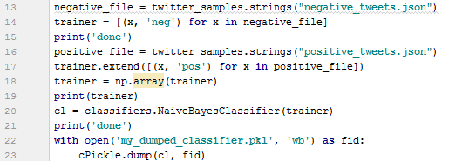
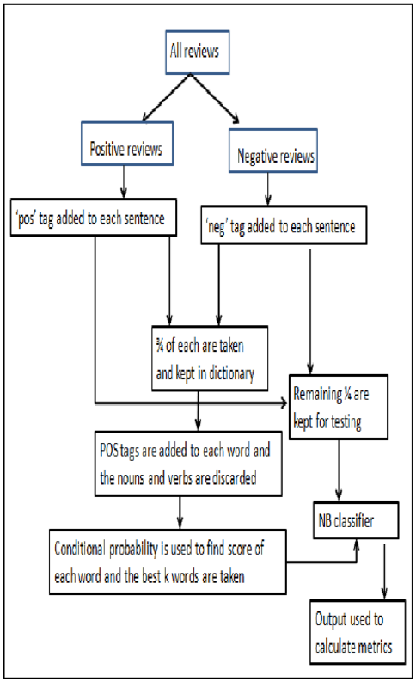
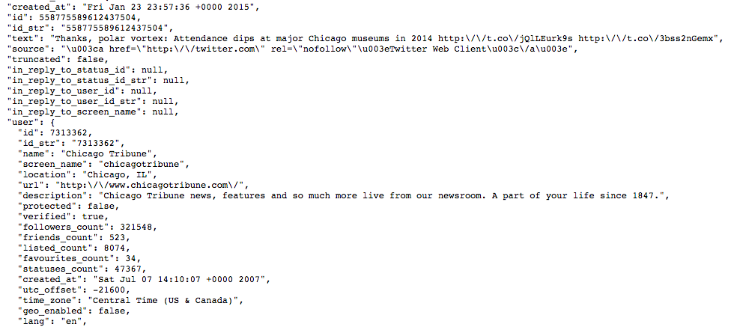
What did I do? (Step 1)
Source: Dey, L., Chakraborty, S., Biswas, A., Bose, B., & Tiwari, S. (2016).
Sentiment Analysis of Review Datasets Using Naive Bayes and K-NN Classifier.
arXiv preprint arXiv:1610.09982.

Slide 5
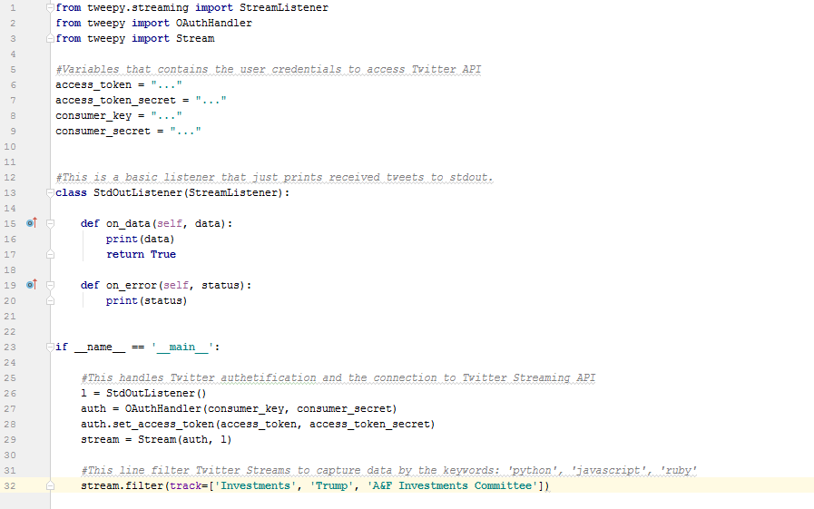
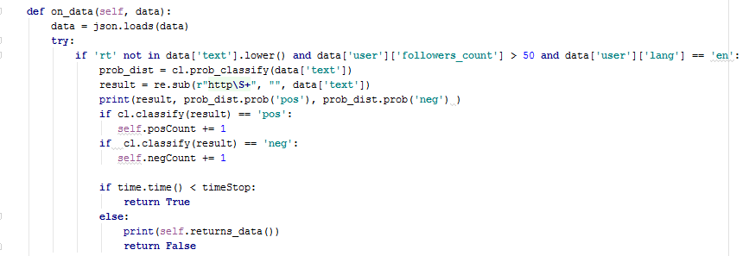
What did I do? (Step 2)

Slide 6
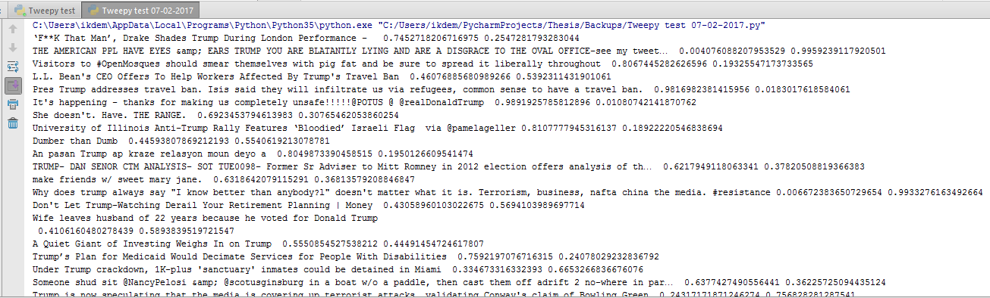
Results so far
Left = chance of sentence being positive, right = chance of sentence being negative.

Slide 7
Conclusion
Developping programming skills/fun
Valuable insights in Twitter sentiments/Stock prices
Might lead to future stock pick (if code works)

Slide 8
Interest in programming?
Interest in programming?
https://www.codecademy.com/
https://www.learnpython.org/
Google everything!
---------------------------------------------------------------------------------------------------------------------------------------
Advanced Programming CIS (HAIT)
Competition Policy and Regulation
Computer programming for EOR

